Slide 1
Data Ingestion and Data Transformation
By
Sriganga Vuthur

Slide 2
Agenda
Title of Project
Overview
Architecture Diagram
Process Flow
Azure Resources Used
Project Requirements
Implementation
Conclusion

Slide 3
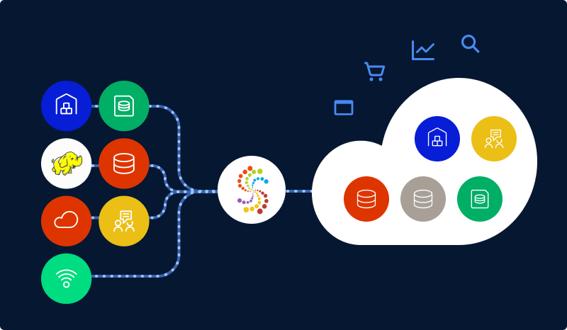
Title of Project
Data Ingestion: Configure and run the ADF pipelines to ingest the Olympics data into Azure Data Lake Storage Gen2.
Data Transformation: Execute the PySpark notebooks in Azure Databricks to perform data transformation tasks.

Slide 4
Overview
This project is designed to showcase how various Azure services can be utilized to ingest, store, transform Olympics-related data. We have employed the following Azure services to achieve these goals:
1) Data Ingestion: Configure and run the ADF pipelines to ingest the Olympics data into Azure Data Lake Storage Gen2.
2) Data Transformation: Execute the PySpark commands in notebooks in Azure Databricks to perform data transformation tasks like sorting, filtering , aggregations with group by etc.,

Slide 5
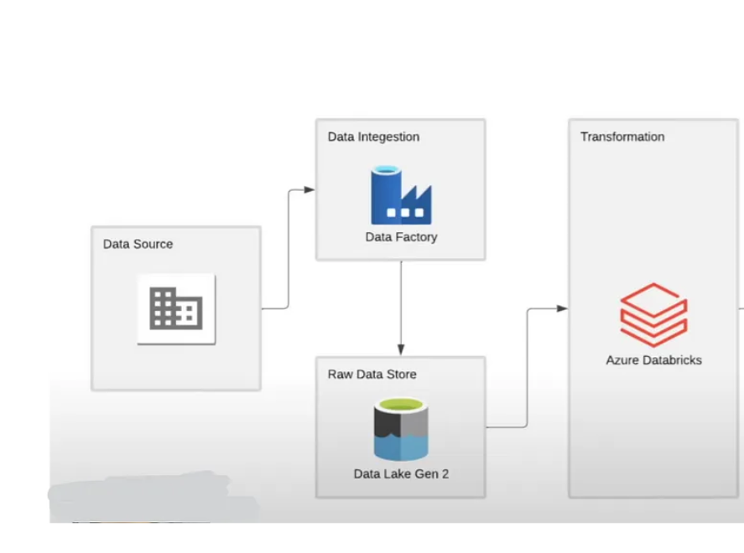
Architecture Diagram

Slide 6
Process Flow
Data Ingestion:
Raw Olympic data from various sources is ingested into Azure Data Lake Storage Gen2 using ADF pipelines.
ADF is configured to handle data movement and transformation activities, ensuring data integrity and security during the ingestion process.
2. Data Transformation:
Azure Databricks is employed to execute PySpark notebooks that perform data transformations on the ingested Olympic data.
PySpark notebooks read data from Azure Data Lake Storage Gen2, apply necessary transformations, and store the processed data back in the data lake.

Slide 7
Azure Resources used
Azure Blob Storage account: Here the raw unprocessed data is uploaded from the various data sources.
Azure Data Lake Storage Gen2:Here the ingested data is stored through Data Copy.
Azure Data Factory (ADF):This is used for data ingestion and performing copy activity.
Azure Databricks: It is used for data transformations.We run various PySpark commands to do data cleaning and transforming.
Python with PySpark: PySpark is the Python API for Apache Spark, which is a fast and general-purpose cluster computing system.

Slide 8
Project Requirements
Data Ingestion:
Source Data Identification
Azure Data Lake Storage Gen2 Configuration
Azure Data Factory (ADF) Pipeline Configuration for Copy Activity
Debugging ADF pipeline
2) Data Transformation:
Azure Databricks Environment Setup
PySpark Databricks Notebook
Notebook Execution

Slide 9
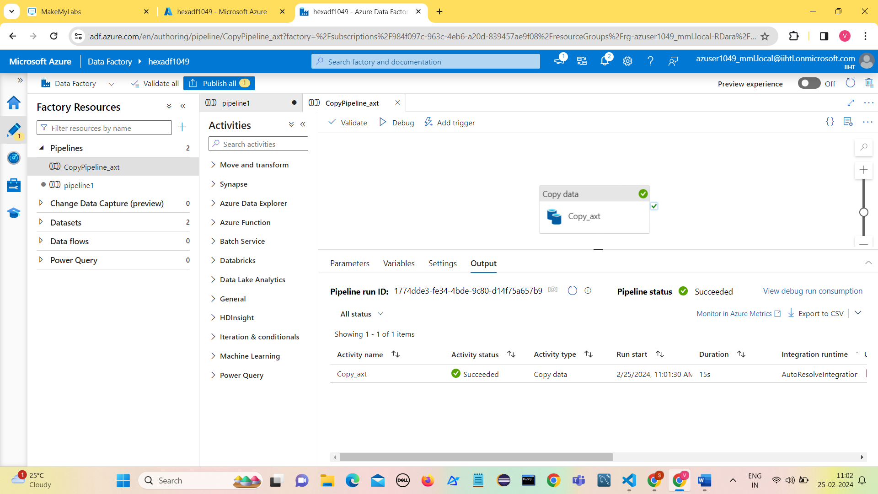
Implementation - DATA INGESTION
Source Data Identification
Azure Blob Storage configuration
Azure Data Lake Storage Gen2 Configuration
Azure Data Factory (ADF) Pipeline Configuration
Run the Pipeline
Verify in the destination folder

Slide 10
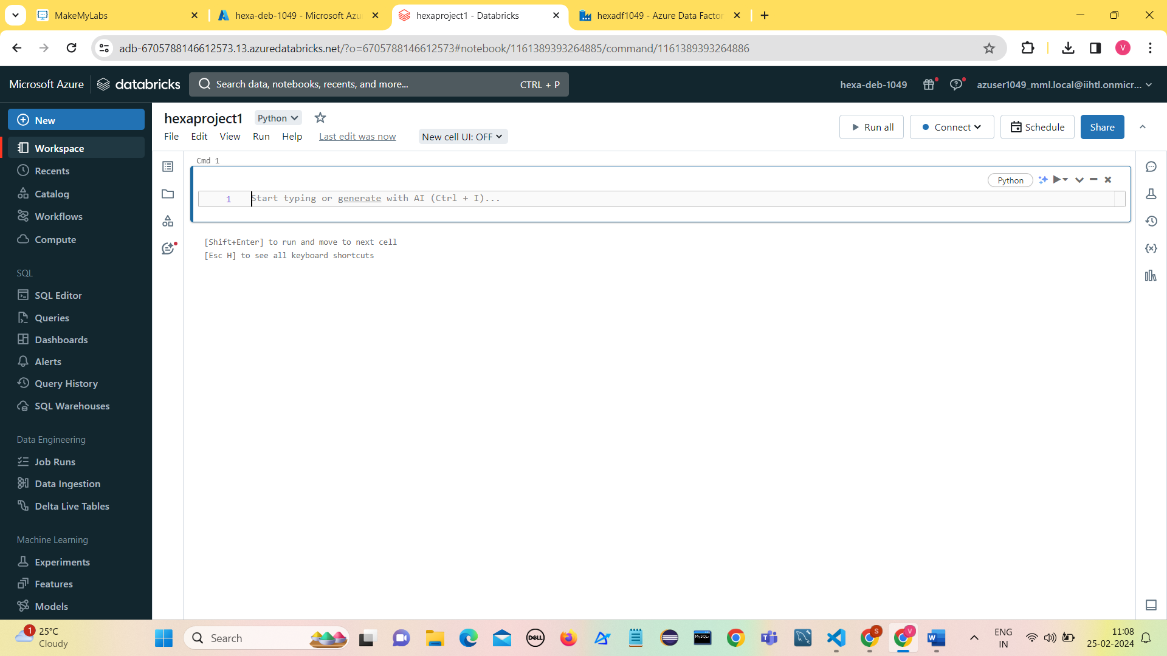
DATA TRANSFORMATION
Azure Databricks Environment Setup
Set up an Azure Databricks workspace in the Azure portal.
Configure clusters within the Databricks workspace with appropriate specifications for running PySpark notebooks.
PySpark Notebook Development
Notebook Execution and Scheduling

Slide 11
DATA TRANSFORMATION
Various transformations can be performed like
Removing null values
Renaming the column names
Selecting distinct values
Sorting
Filtering based on condition.
Using aggregate functions with groupBy clause like SUM(),MIN(),MAX(),AVG(),MEAN(),COUNT() and agg()

Slide 12
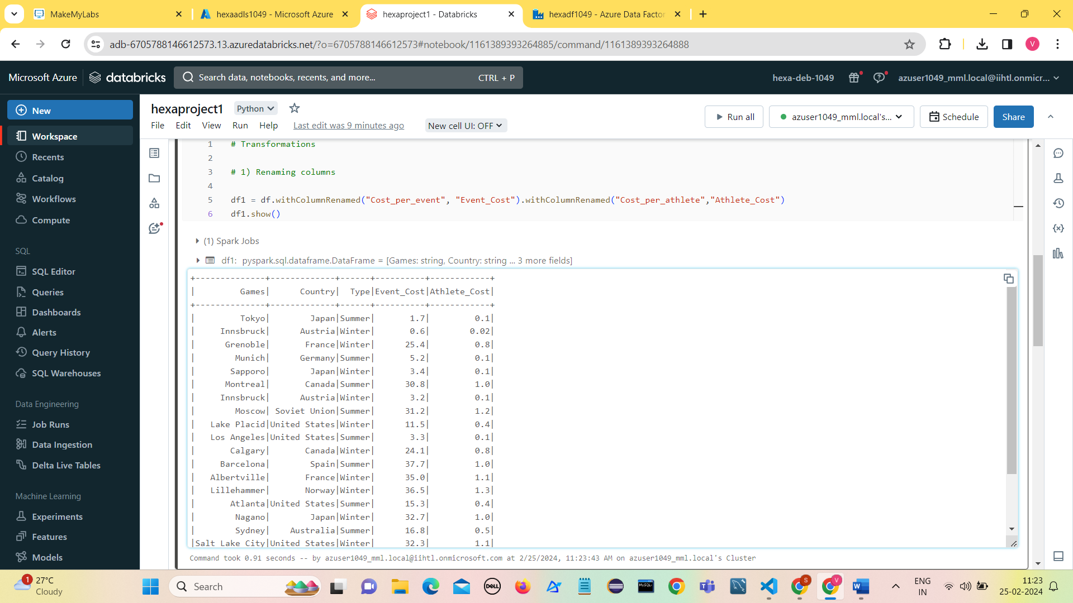
Renaming columns

Slide 13

Selecting Distinct Values

Slide 14
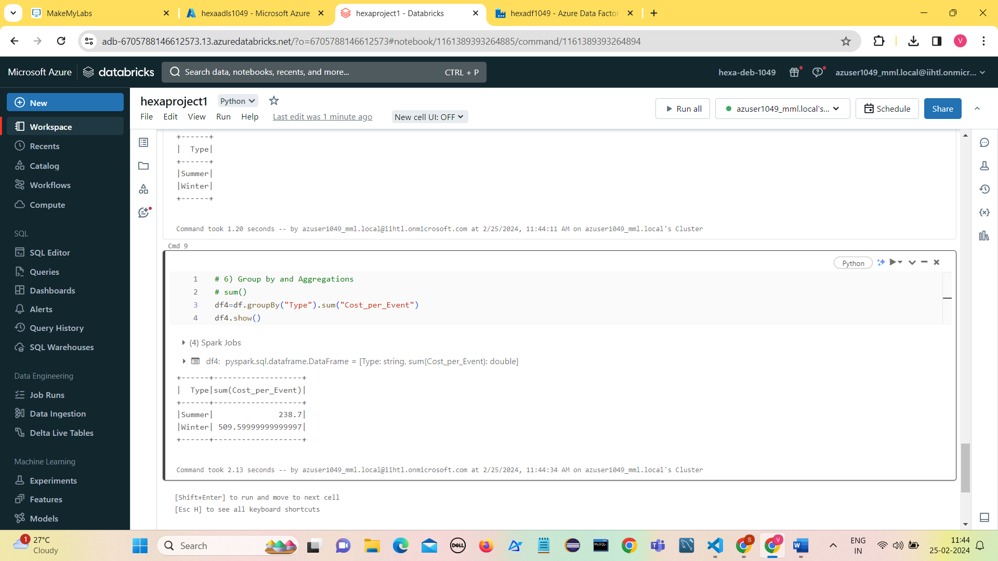
Performing Aggregations
Here we are taking Sum for example:

Slide 15
Conclusion
The Integration of Azure Data Factory (ADF) pipelines for data ingestion and Azure Databricks for data transformation provides a comprehensive solution for handling Olympics data within the Azure ecosystem.
ADF simplifies and automates the process of bringing in data from diverse sources and depositing it into Azure Data Lake Storage Gen2.
This serves as a reliable and scalable data repository.
On the other hand, Azure Databricks, with its PySpark capabilities, facilitates efficient and parallelized data transformations, ensuring that the raw Olympics data is transformed into a structured and analyzable format.
The combination of these services not only streamlines the end-to-end data processing workflow but also takes advantage of the cloud's scalability and computational power.

Slide 16
THANK YOU

